Slide 1

Working with the
Solow Growth Model

Slide 2
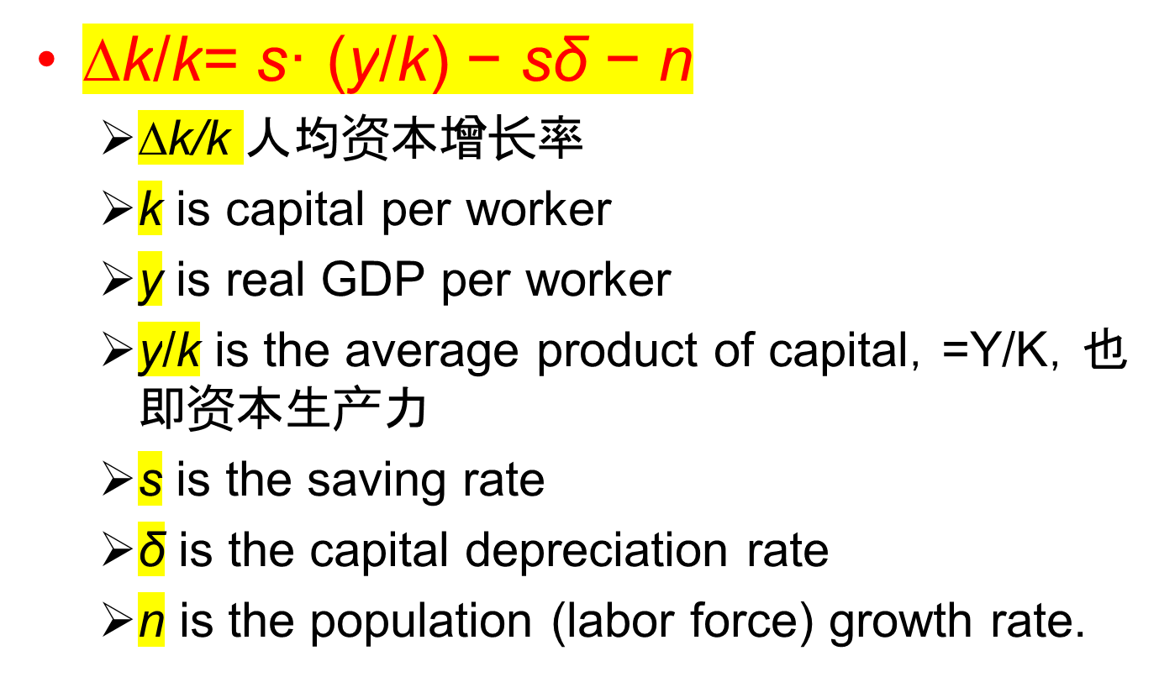
Solow Growth Model

Slide 3
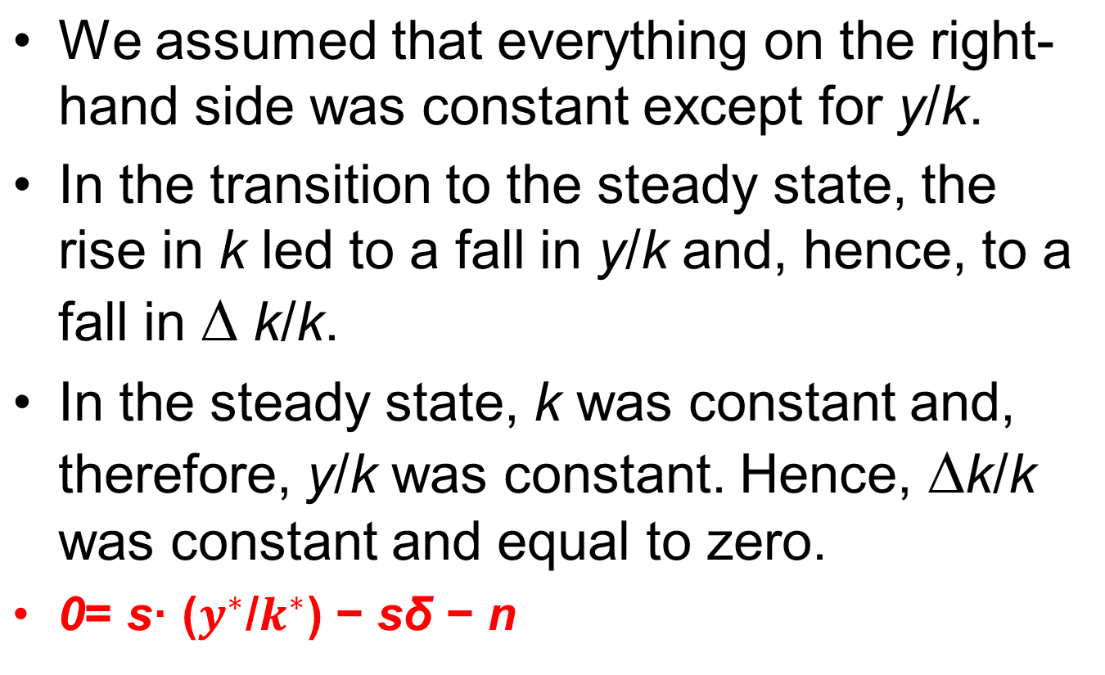
Solow Growth Model
Steady State

Slide 4
Solow Growth Model
Production function
  y = A · f (k)
Solow Growth Equation
  ∆k/k= s A· f(k)/k − sδ − n
  即：∆k/k 最终可以表达为k 的函数。

Slide 5
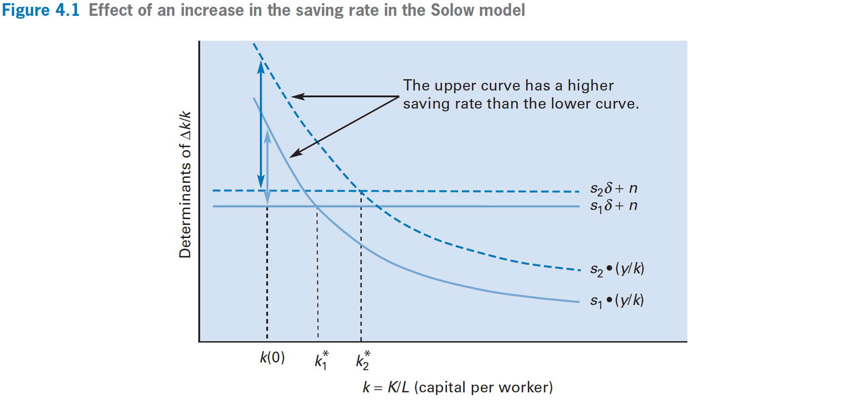

Solow Growth Model
Change in savings rate (s)

Slide 6
Solow Growth Model
Change in savings rate (s)
In the short run, an increase in the saving rate s raises the growth rate of capital per worker.
This growth rate remains higher during the transition to the steady state.

Slide 7
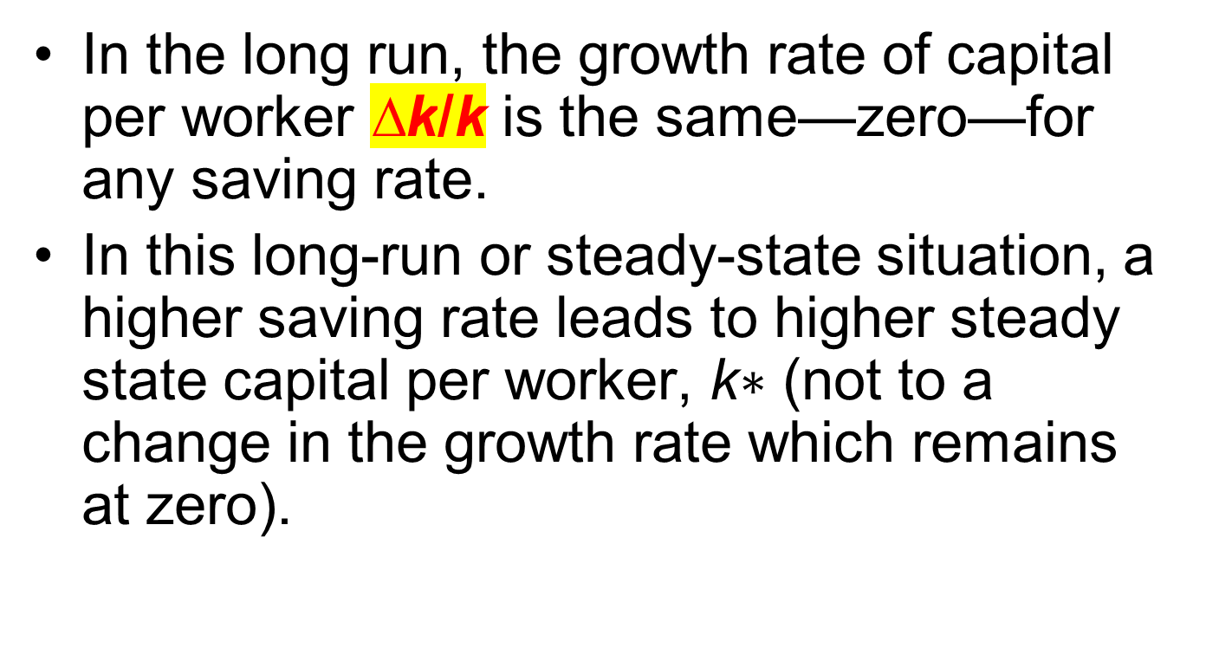
Solow Growth Model
Change in savings rate (s)

Slide 8
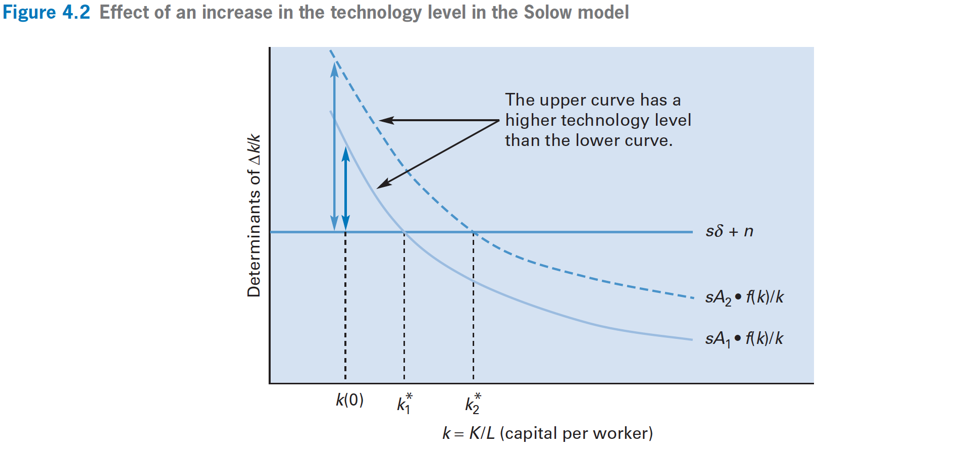
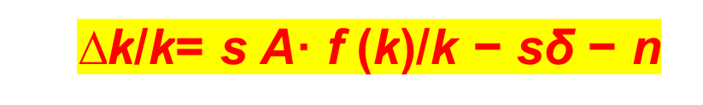
Solow Growth Model
Change in technology level (A)

Slide 9
Solow Growth Model
Change in technology level (A)
In the short run, an increase in the technology level, A, raises the growth rates of capital and the growth rates of real GDP per worker.
These growth rates remain higher during the transition to the steady state.

Slide 10
Solow Growth Model
Change in technology level (A)
In the long run, the growth rates of capital and real GDP per worker are the same—zero—for any technology level.
In this long-run or steady state situation, a higher technology level leads to higher steady-state capital and real GDP per worker, k∗ and y∗ (not to changes in the growth rates which remain at zero).

Slide 11
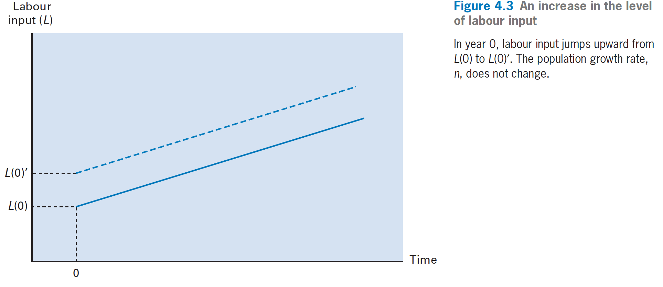
Solow Growth Model
Change in the labor input (L0)

Slide 12
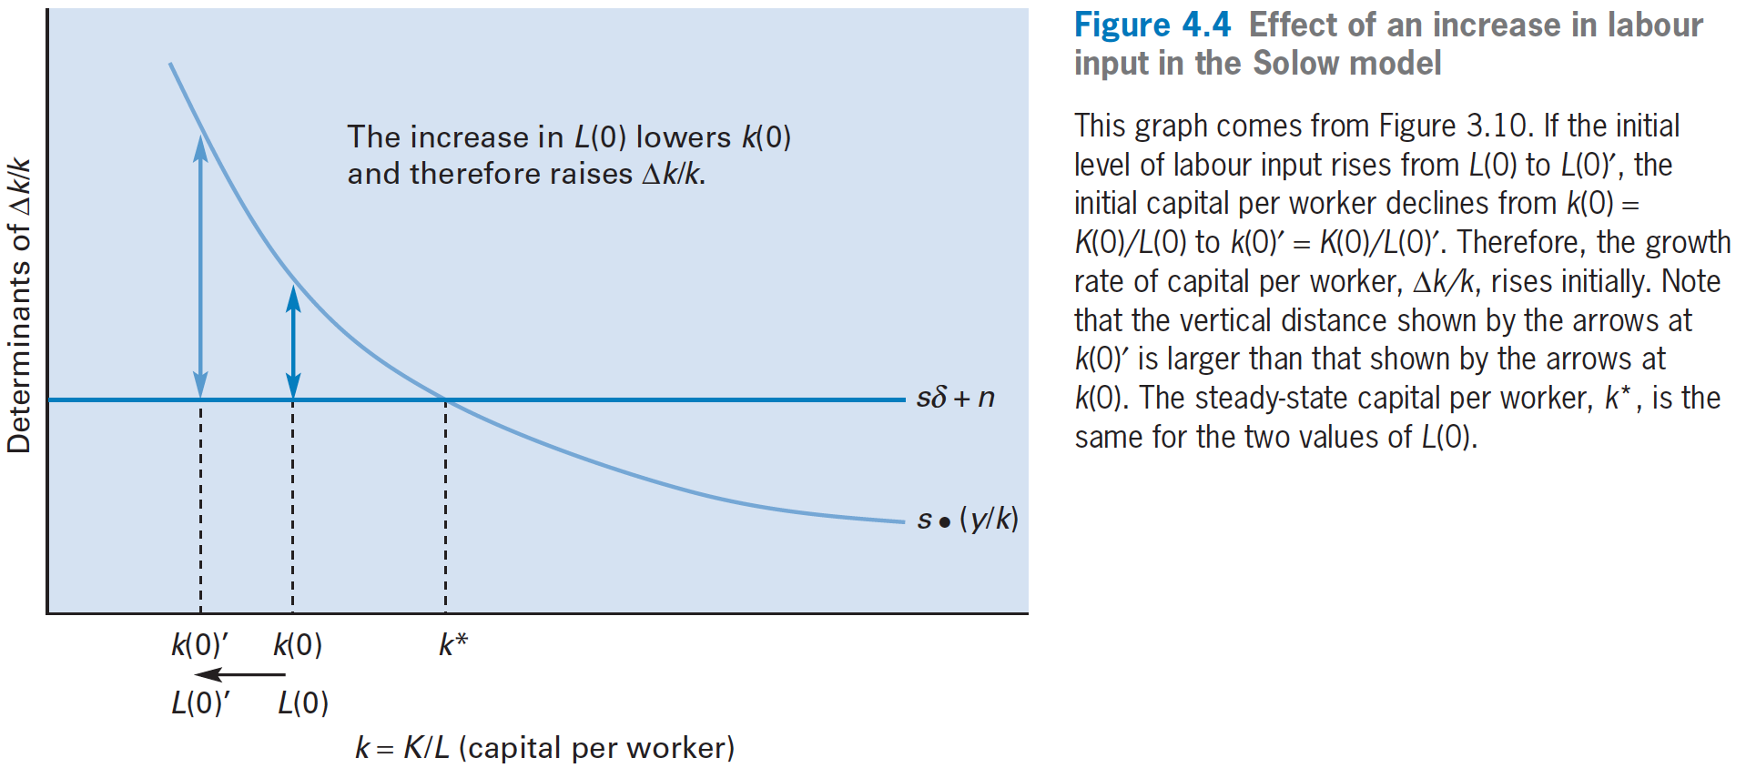
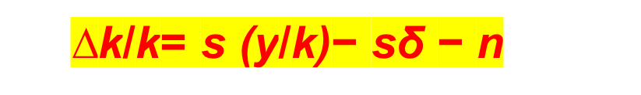
Solow Growth Model
Change in the labor input (L0)

Slide 13
Solow Growth Model
Change in the labor input (L0)
In the short run, an increase in initial labor input, L(0), raises the growth rates of capital and real GDP per worker.
These growth rates remain higher during the transition to the steady state.

Slide 14
Solow Growth Model
Change in the labor input (L0)
In the long run, the growth rates of capital and real GDP per worker are the same—zero—for any initial level of labor input, L(0).
The steady-state capital and real GDP per worker, k∗ and y∗, are the same for any L.
In the long run an economy with twice as much labor input has twice as much total capital and total real GDP.
记住： ∆k/k和∆y/y为零，即人均资本和人均GDP的增速为零，不是说∆K/K 或者 ∆Y/Y为零。资本和GDP总量的增速还是等于人口的增速(n)，为什么？

Slide 15
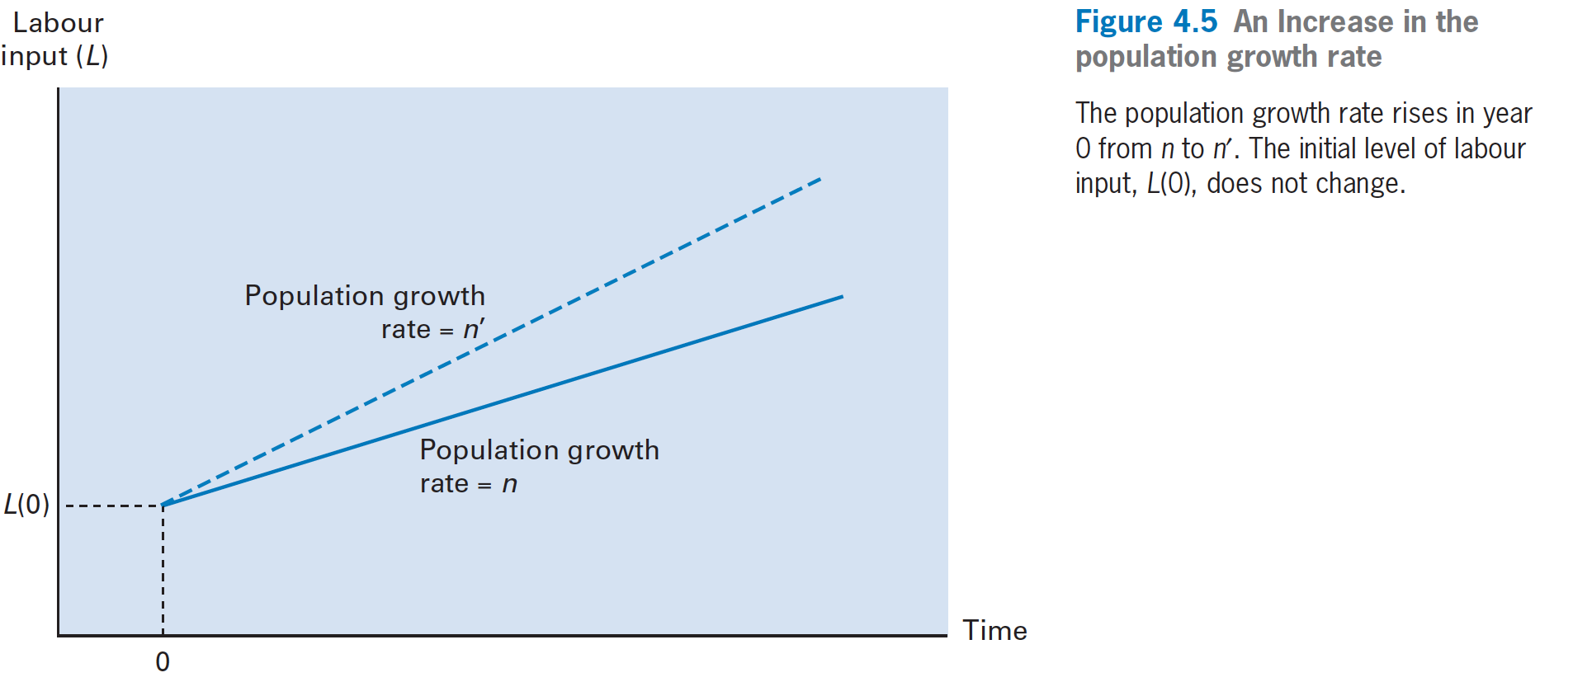
Solow Growth Model
Change in population growth rate (n)

Slide 16
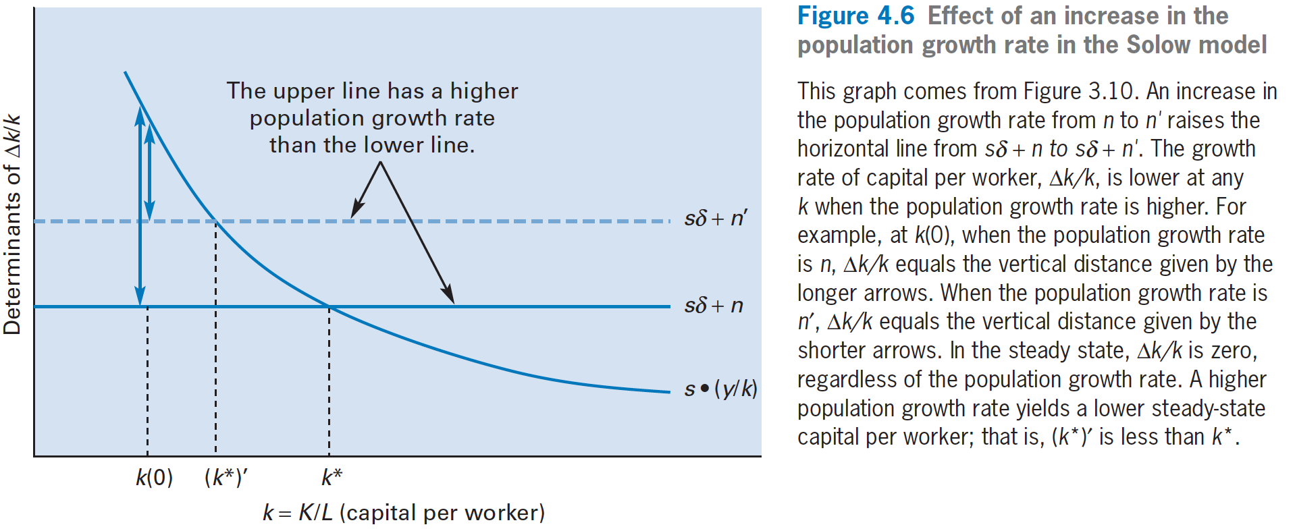
Solow Growth Model
Change in population growth rate (n)

Slide 17
Solow Growth Model
Change in population growth rate (n)
In the short run, a higher n lowers ∆k/k and ∆ y/y.
These growth rates remain lower during the transition to the steady state.

Slide 18
Solow Growth Model
Change in population growth rate (n)
In the steady state, ∆k/k and ∆y/y are zero for any n.
A higher n leads to lower steady-state capital and real GDP per worker, k∗ and y∗, (not to changes in the growth rates, k/k and y/y which remain at zero).
A change in n does affect the steady-state growth rates of the levels of capital and real GDP, ∆K/K (= ∆k/k+n ) and ∆Y/Y(= ∆y/y+n ).

Slide 19
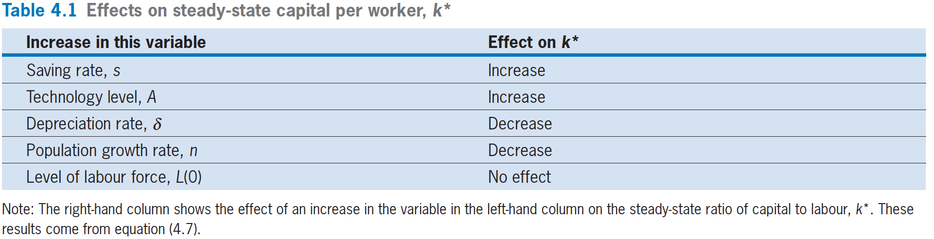
Solow Growth Model
Convergence
k* = k*[ s, A, n, δ, L(0) ]
(+) (+) (−) (−) (0)

Slide 20
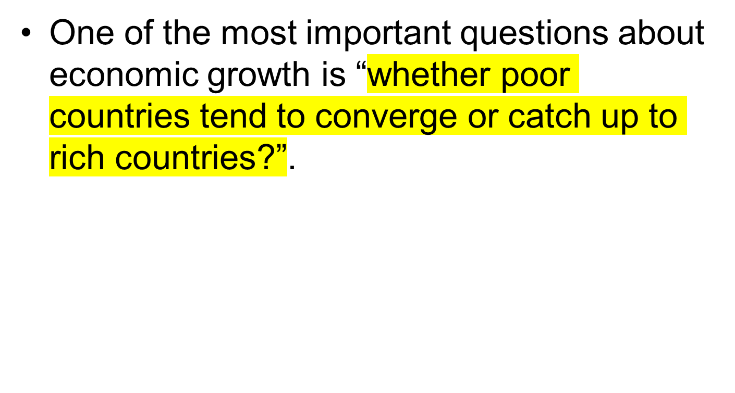
Solow Growth Model
Convergence

Slide 21
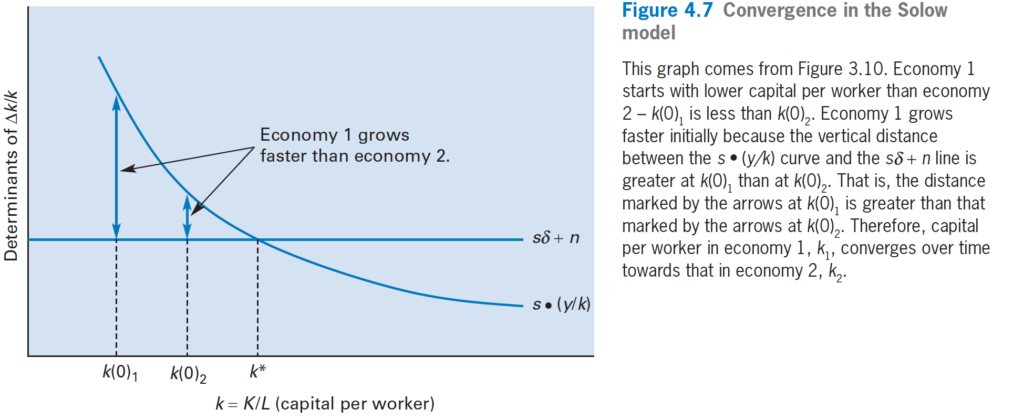
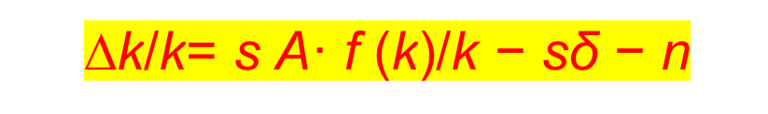
Solow Growth Model
Convergence

Slide 22
Solow Growth Model
Convergence
Economy 1 starts with lower capital per worker than economy 2—k(0)₁ is less than k(0)₂.
Economy 1 grows faster initially because the vertical distance between the s·(y/ k) curve and the sδ + n line is greater at k(0)₁ than at k(0)₂.
Therefore, capital per worker in economy 1, k₁, converges over time toward that in economy 2, k₂.

Slide 23
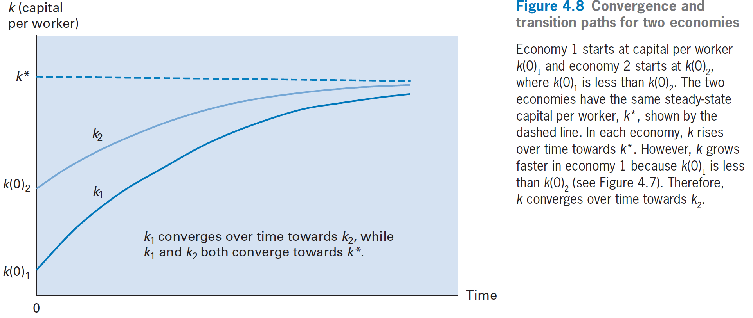
Solow Growth Model
Convergence

Slide 24
Solow Growth Model
Convergence
The two economies have the same steady-state capital per worker, k*, shown by the dashed blue line.
In each economy, k rises over time toward k*. However, k grows faster in economy 1 because k(0)₁ is less than k(0)₂.
Therefore, k₁ converges over time toward k₂.

Slide 25
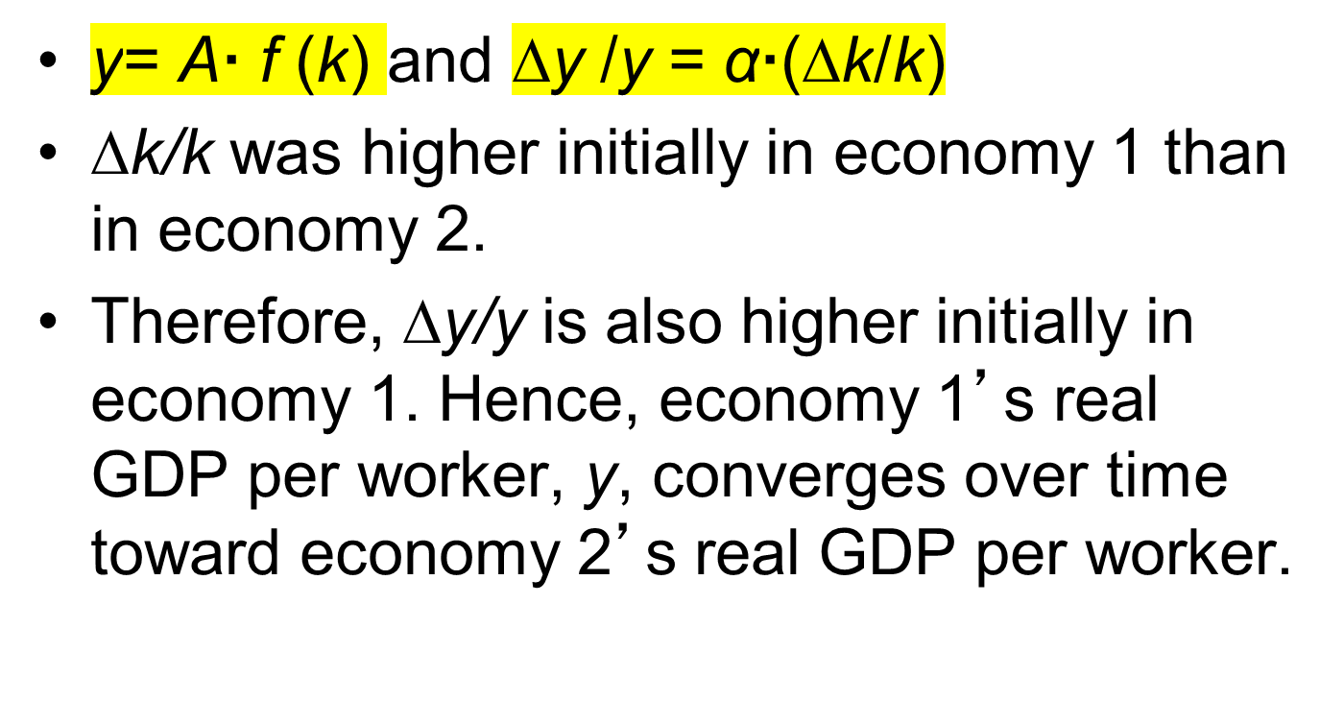
Solow Growth Model
Convergence

Slide 26
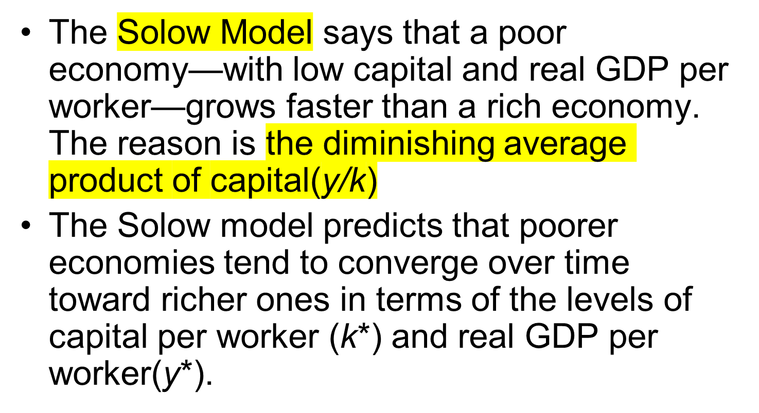
Solow Growth Model
Convergence

Slide 27
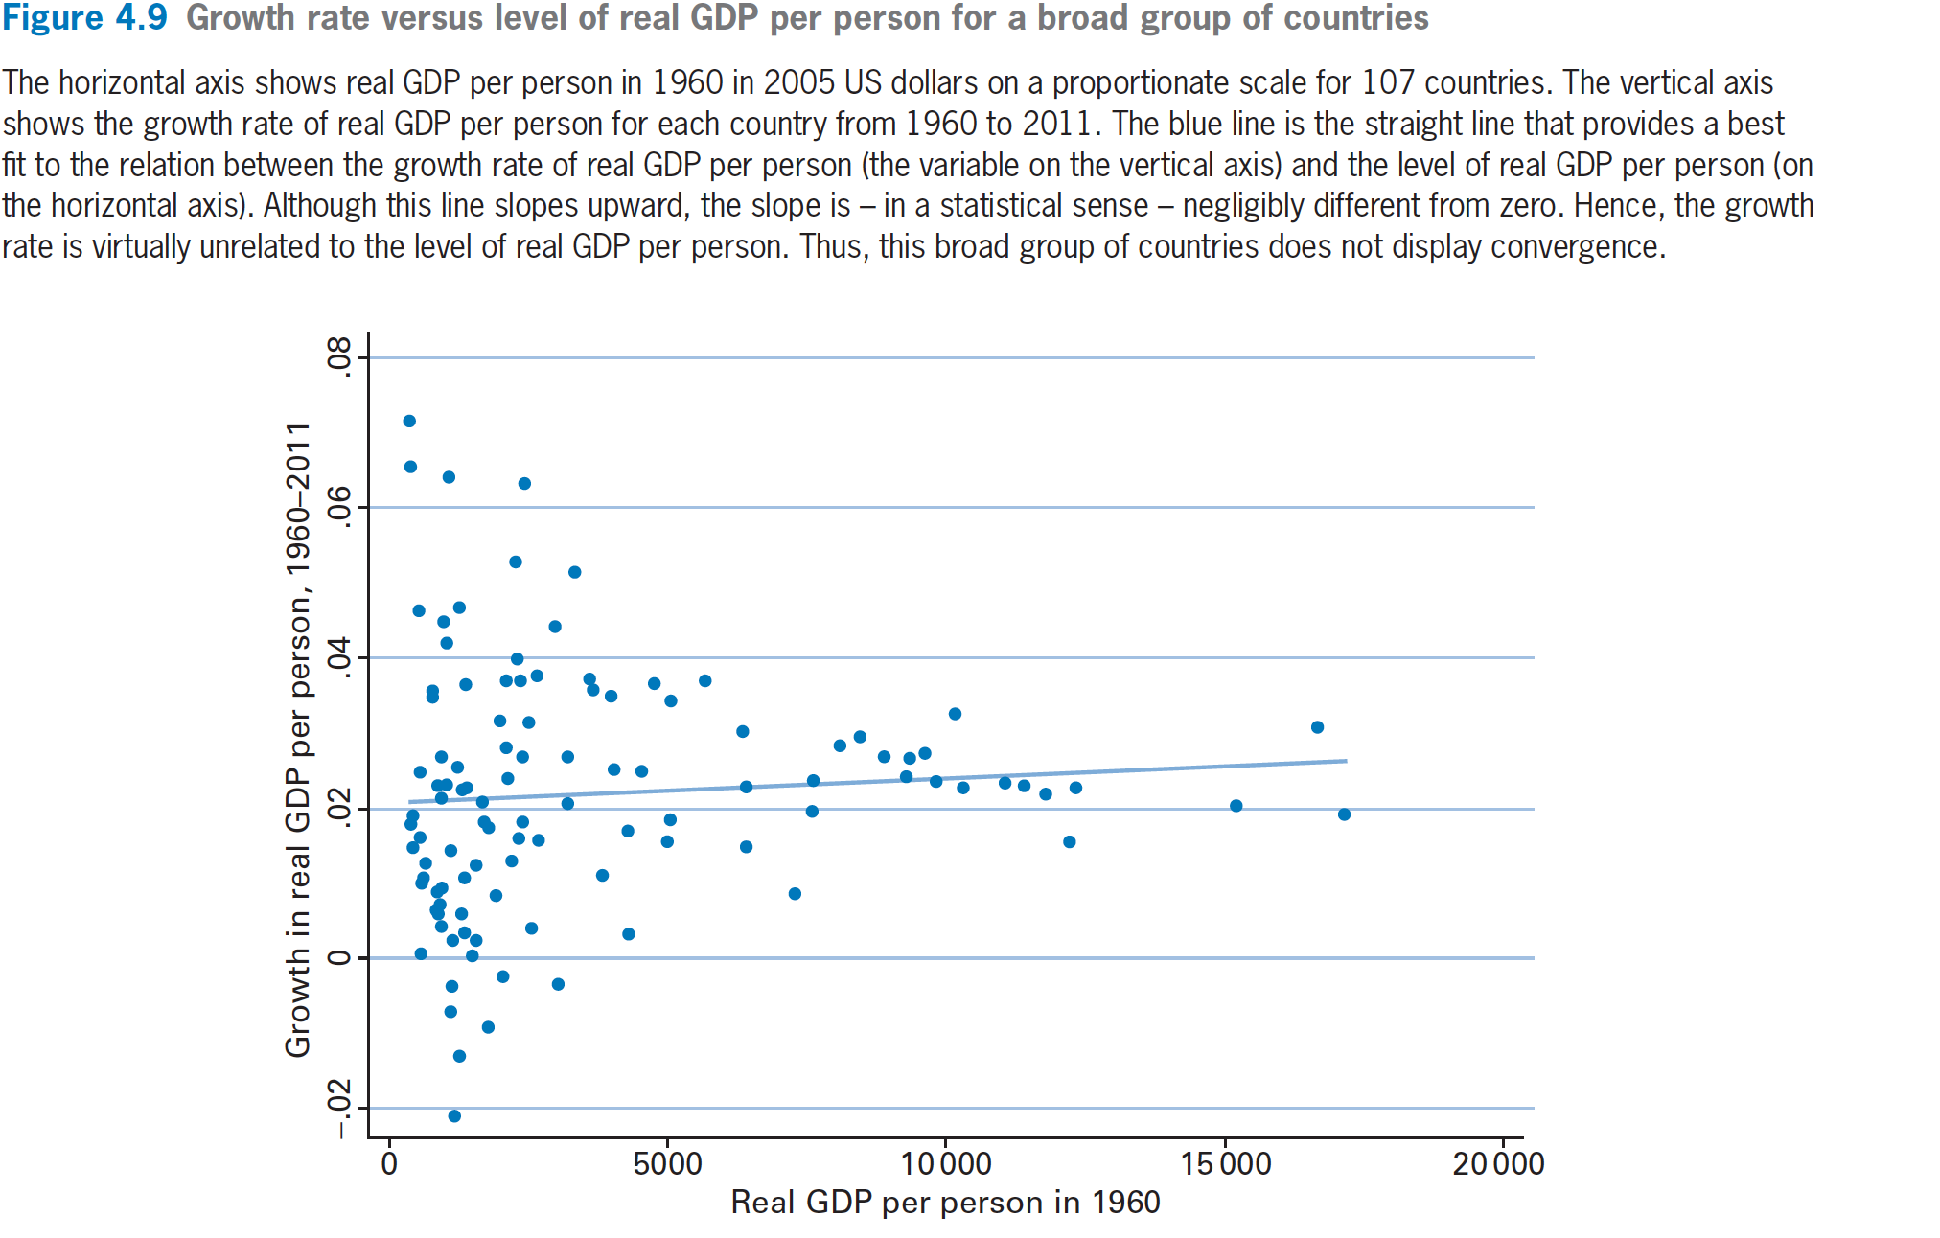
Solow Growth Model
Convergence

Slide 28
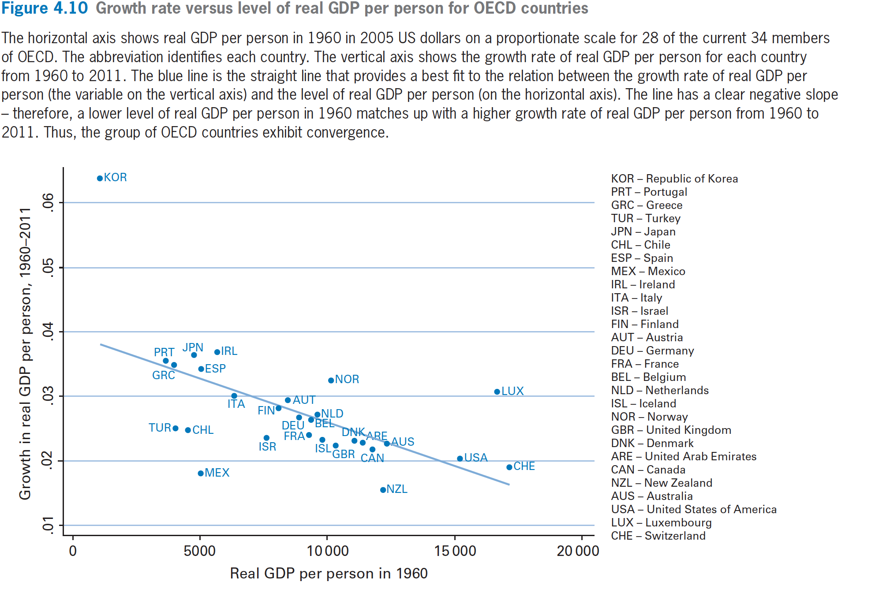
Solow Growth Model
Convergence

Slide 29
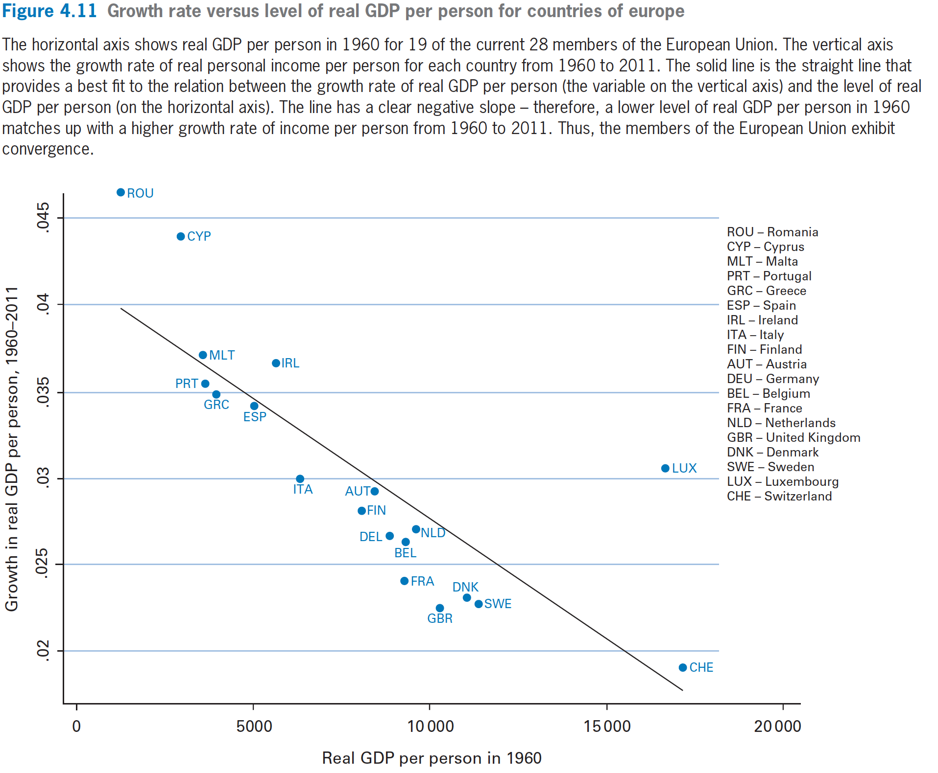

Slide 30
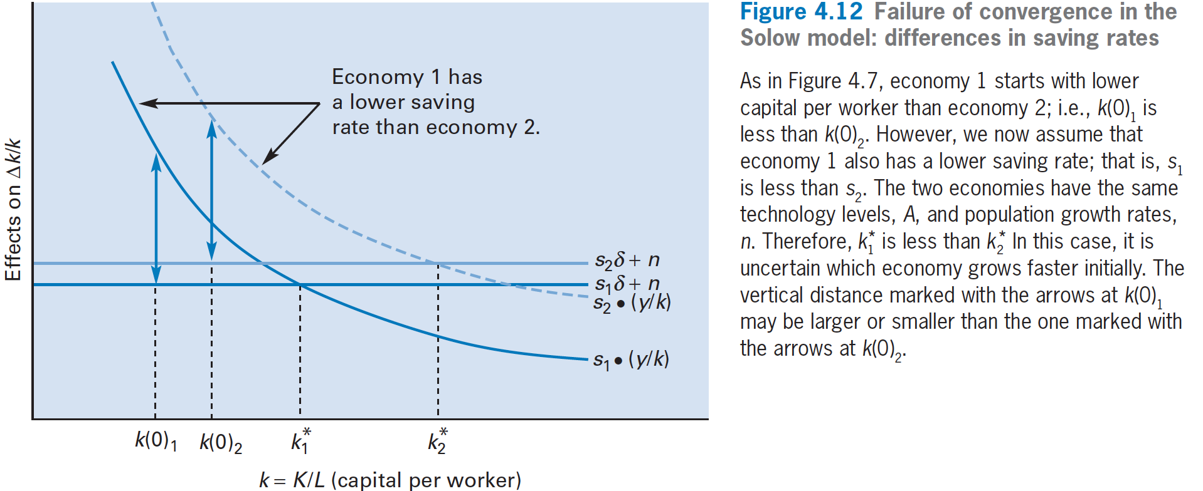

Solow Growth Model
Convergence

Slide 31
Solow Growth Model
Convergence
Economy 1 starts with lower capital per worker than economy 2，（maybe L(0)₁ is bigger）
  k(0)₁ < k(0)₂.
Assume that economy 1 also has a lower saving rate;
  s₁ < s₂.
The two economies have the same technology levels, A, and population growth rates, n.
Therefore, k*₁ is less than k*₂ .
It is uncertain which economy grows faster initially. The vertical distance marked with the blue arrows cannot tell which one is longer.

Slide 32
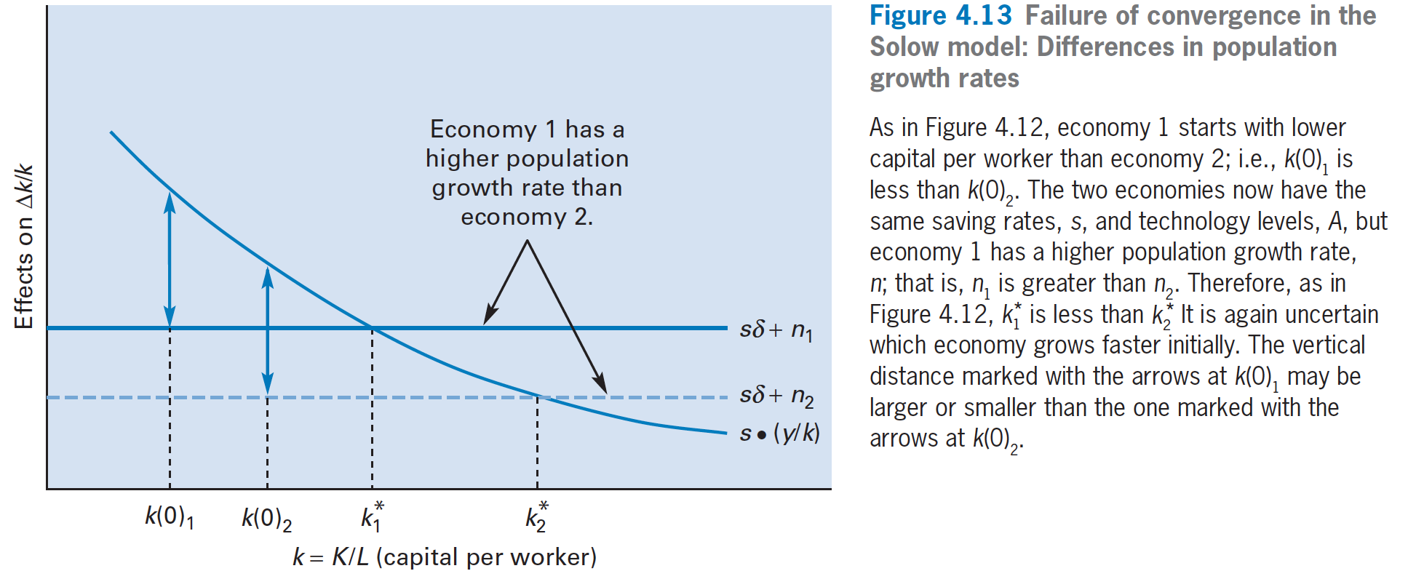

Solow Growth Model
Convergence

Slide 33
Solow Growth Model
Convergence
Economy 1 starts with lower capital per worker than economy 2, （maybe L(0)₁ is bigger）:
  k(0)₁ < k(0)₂.
The two economies now have the same saving rates, s, and technology levels, A, but economy 1 has a higher population growth rate, n;
  n₁ > n₂.
Therefore, k*₁ is less than k*₂ .
It is again uncertain which economy grows faster initially. The vertical distance marked with the blue arrows again cannot tell which one is longer.

Slide 34
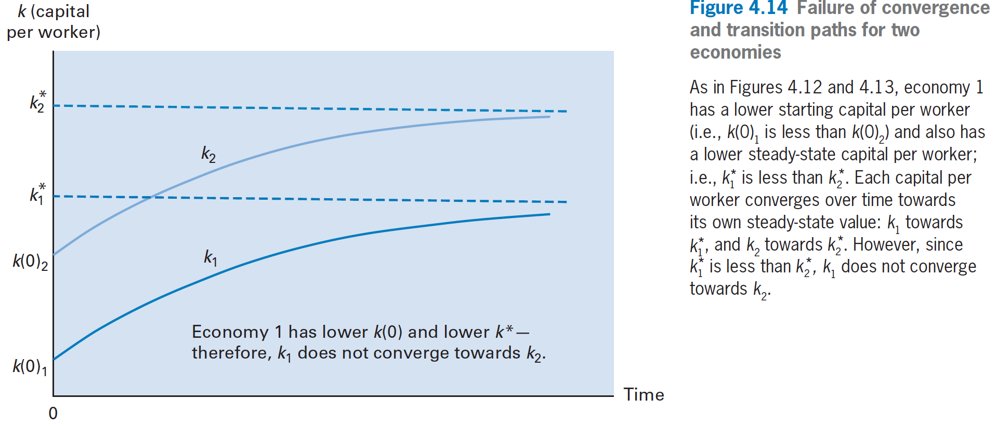
Solow Growth Model
Convergence

Slide 35
Solow Growth Model
Convergence
Economy 1 has a lower starting capital per worker—k(0)₁ < k(0)₂—and also has a lower steady-state capital per worker— k*₁ is less than k*₂ .
Each capital per worker converges over time toward its own steady-state value: k₁ toward k*₁ ,and k₂ toward k*₂ .
However, since k*₁ is less than k*₂ , k₁ does not converge toward k₂.

Slide 36
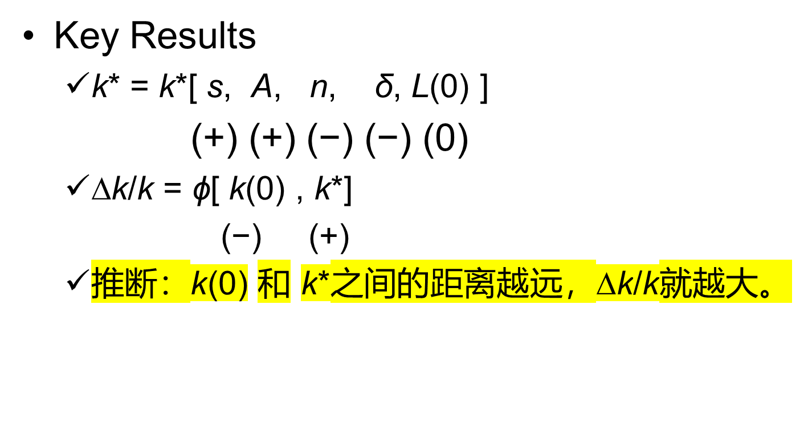
Solow Growth Model
Convergence

Slide 37
Solow Growth Model
Convergence
Conditional convergence: 条件收敛
  a lower k(0) predicts a higher ∆k/k, conditional on k*.
  两个经济体的稳态k*不同，则k*/k(0)越大的国家，就说明这个经济体的当下水平距离其稳态水平越远，因此这个经济体和人均资本和人均产出的增长率越高。

Slide 38
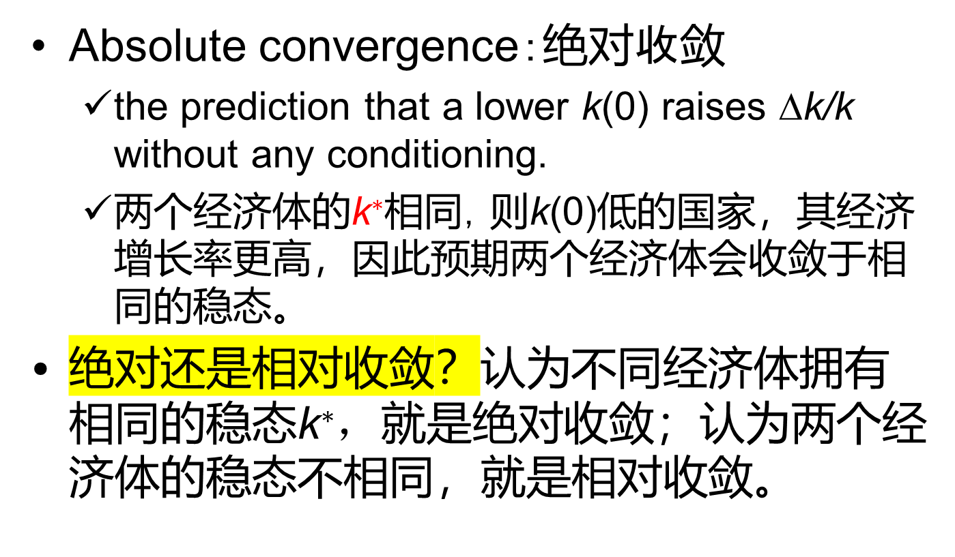
Solow Growth Model
Convergence

